Slide 1
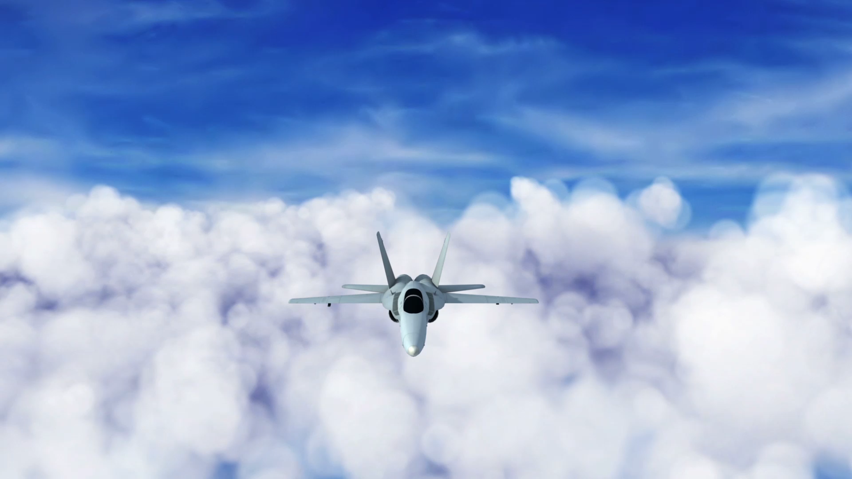
Missile Guidance, NAVIGATION, & CONTROL
- Khushant Khurana

Slide 2
Problem statement
The flight path of the missile needs to be adjusted as the target is moving in space. Accordingly, the missile needs a navigation model to determine its current state, guidance model to adjust the flight path angle, and control model to track the required flight path angle.

Slide 3
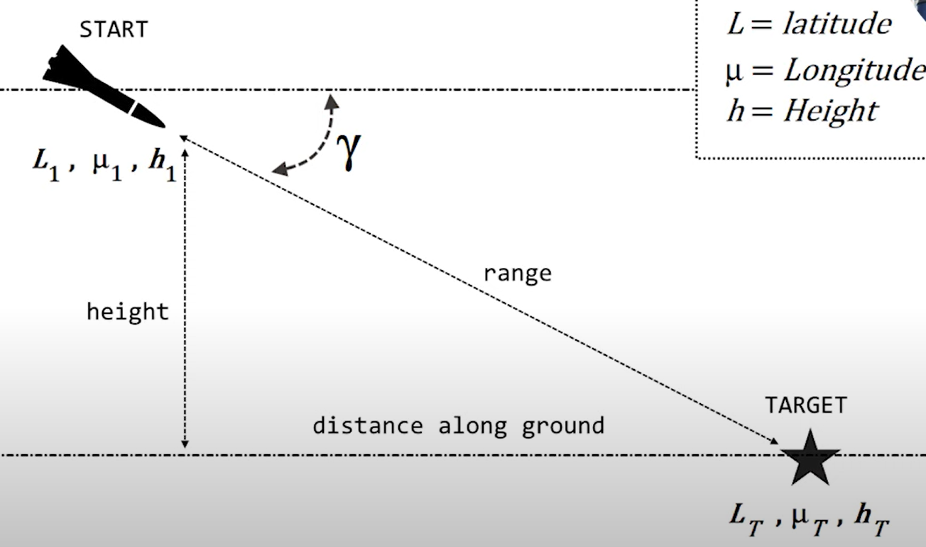
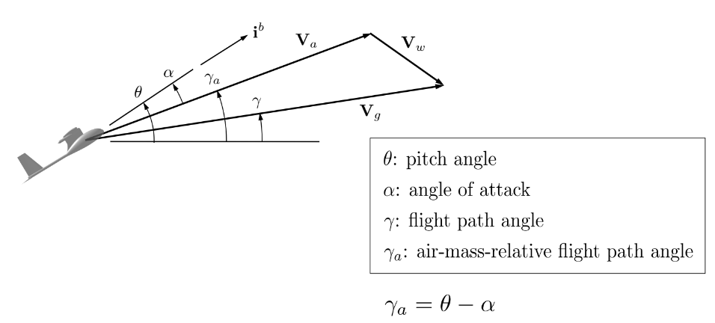
MODELLING THE MISSILE

Slide 4
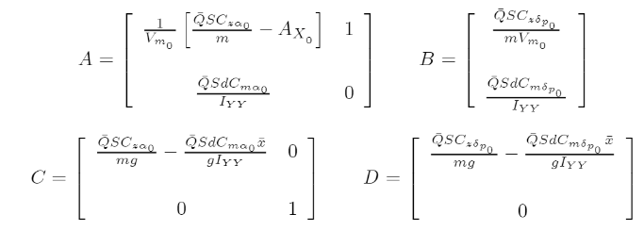
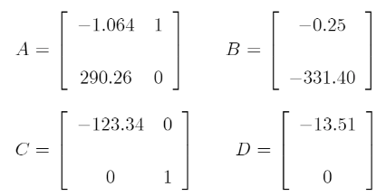
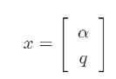
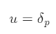
MISSILE DYNAMICS
Poles = -17, 16 (Unstable system)
DYNAMICS
STATE VECTOR
INPUT TORQUE
Source: “Missile Longitudinal Autopilots: Connections Between Optimal Control and Classical Topologies” by Raytheon Technologies

Slide 5
Short period approximation
Pitch angle and pitch velocity are in the same phase. So there is no side slip angle.
Roll and Yaw velocities are 0 to avoid coupling.
Neglect thrust effects (so no forward acceleration). Considered to be the equilibrium point!!!!

Slide 6
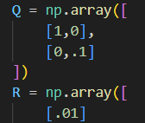
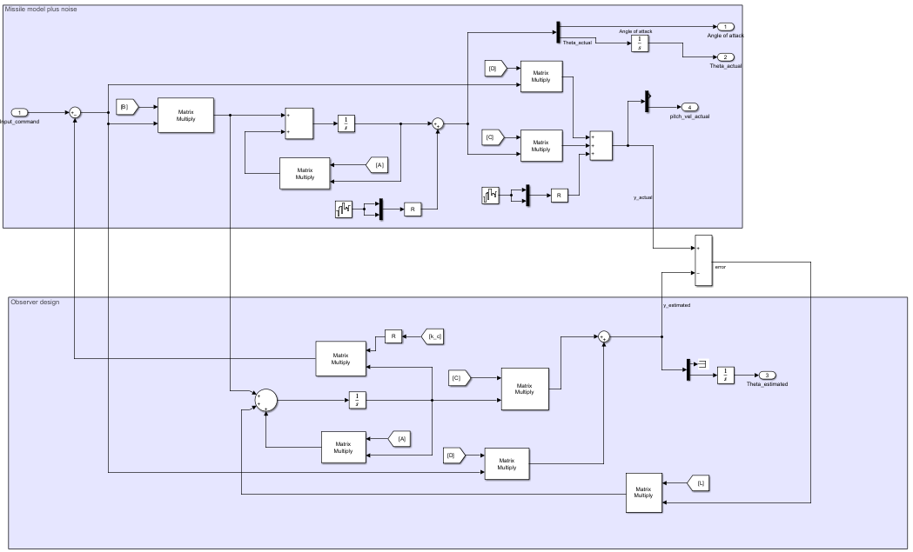
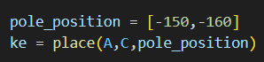
IMPLEMENTING NAVIGATION (WHERE AM I ? )
LQR CONTROL
Kalman gain

Slide 7
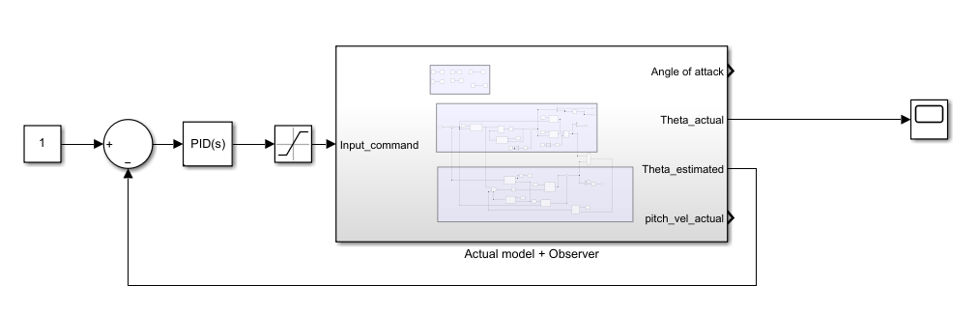
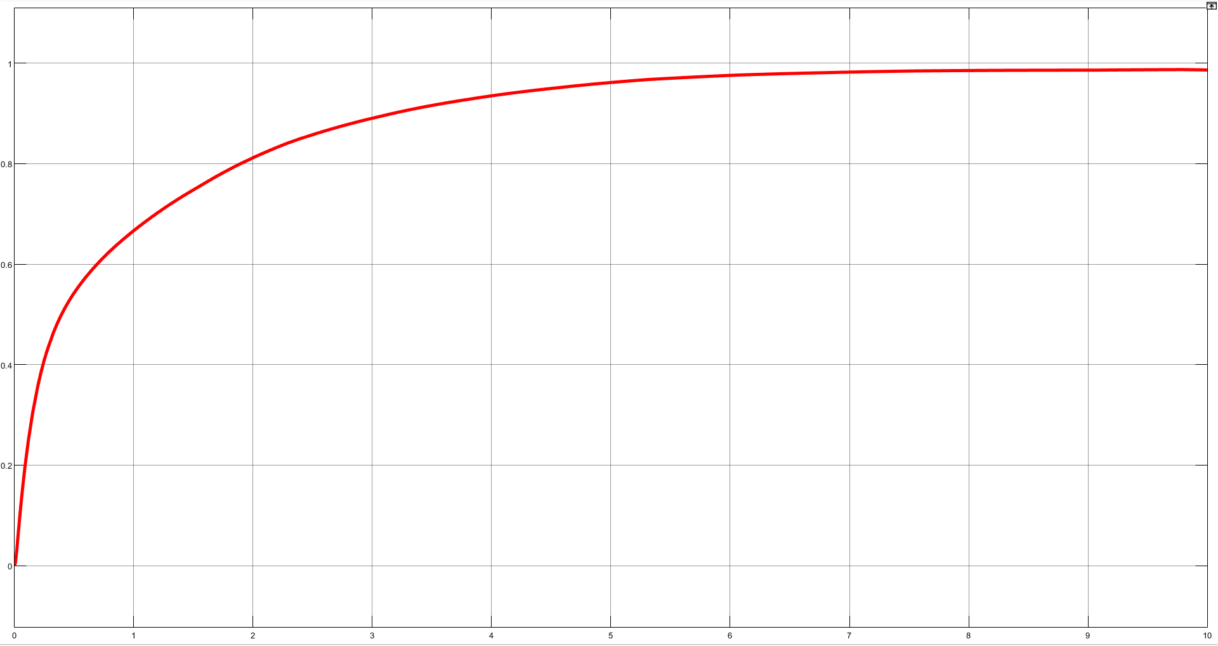
TESTING NAVIGATION MODEL
Step response!

Slide 8
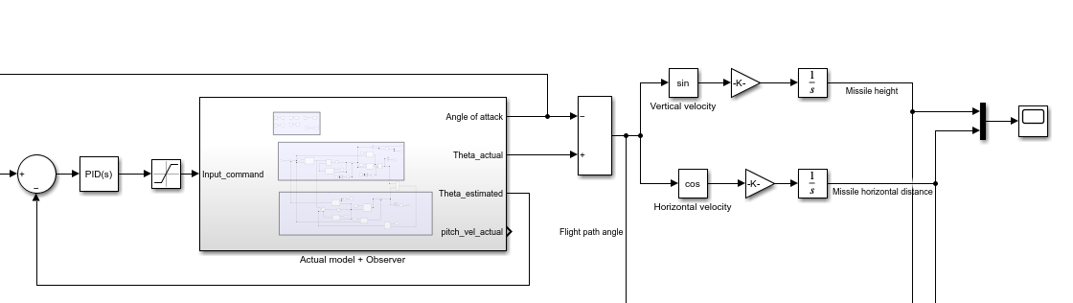
GUIDANCE MODEL
Finding Flight Path Angle
Finding x and z location

Slide 9
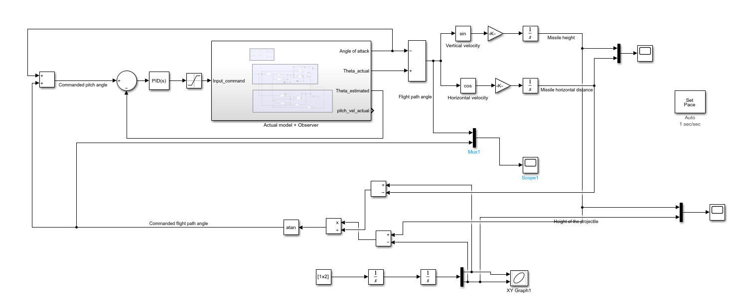
GUIDANCE MODEL
Target projectile
Guidance math

Slide 10
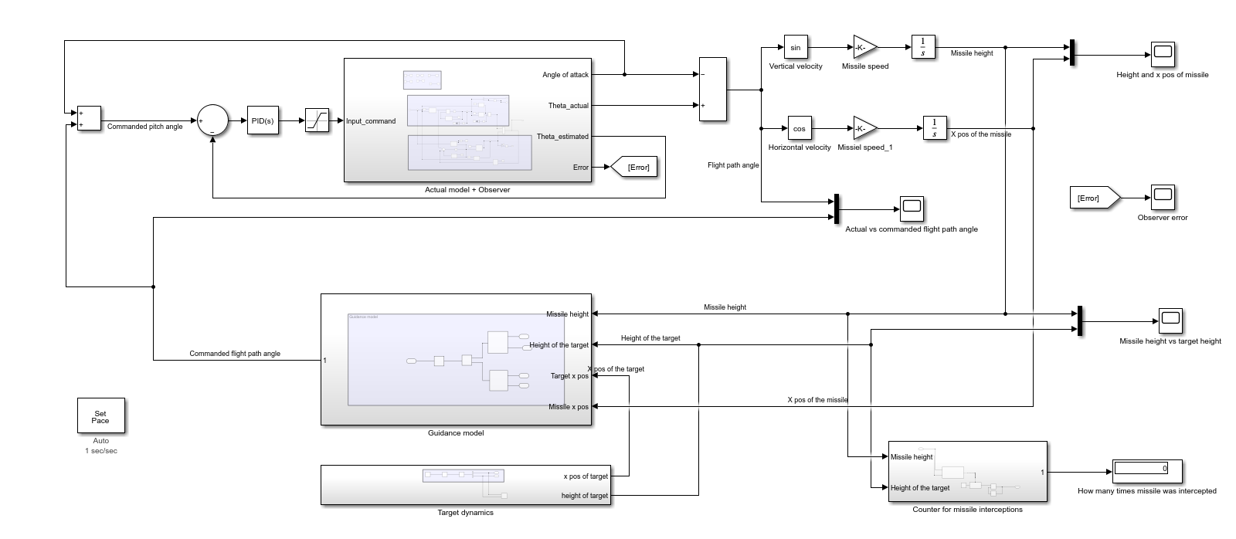
Complete GNC MODEL

Slide 11
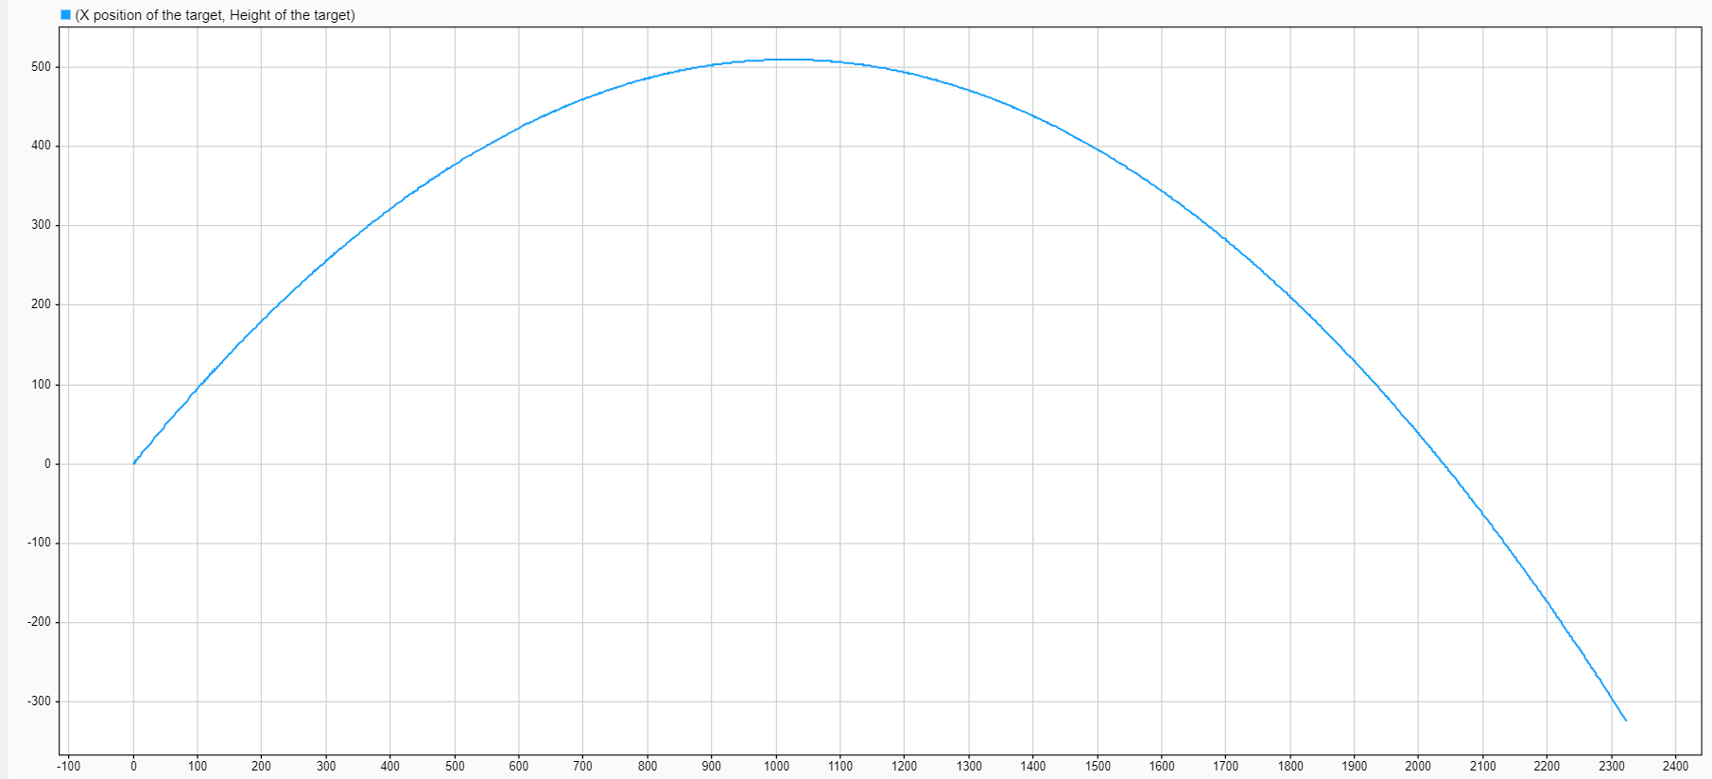
Target Projectile

Slide 12
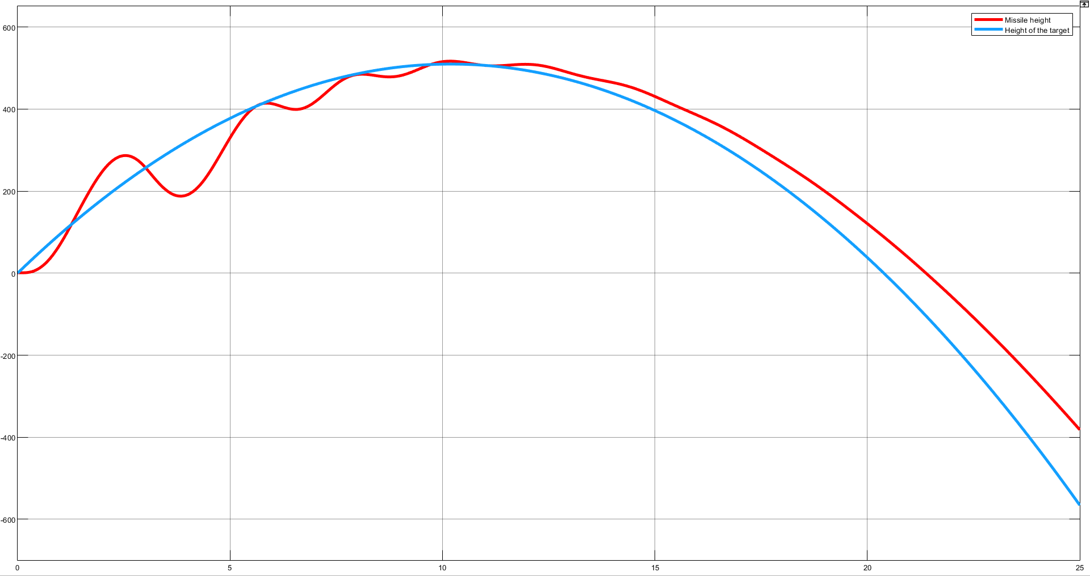
TRACKING RESULTS

Slide 13
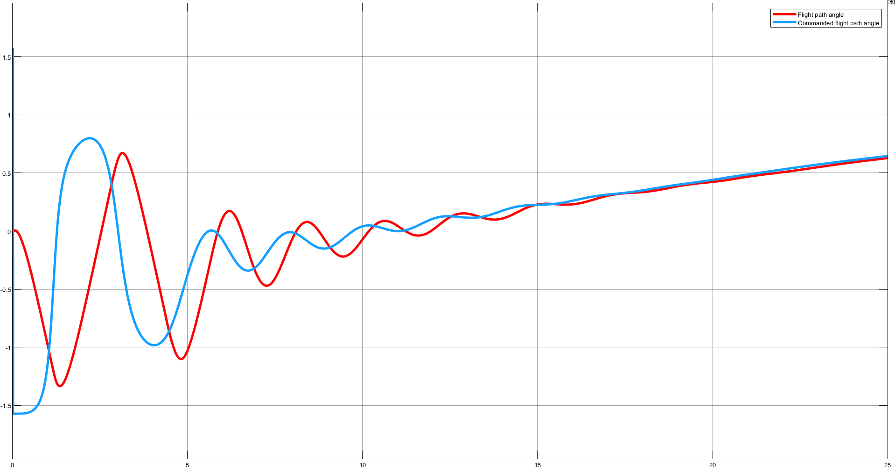
FLIGHT PATH ANGLE

Slide 14
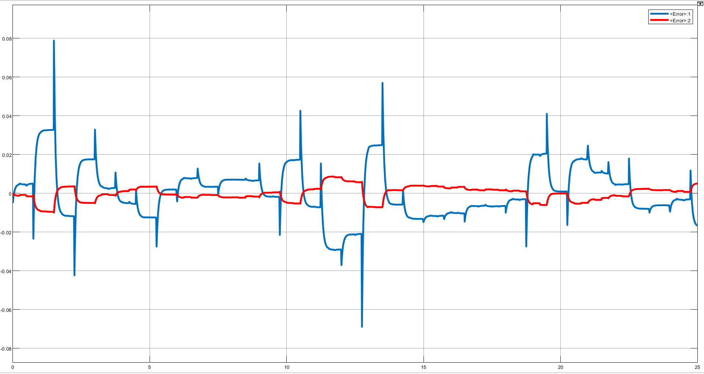
Error between true and estimated state

